Slide 1




YALE D1
VARSITY BRAWL
Tyler Chen, Nicholas Lee, Oliver Lin, Danny Assi, Jared Wyetzner

Slide 2
Table of Contents
Project Introduction
Ansatz Testing
Optimizer Improvements
Hamiltonian Design
Results
Conclusion
IonQ’s Challenge

Slide 3
Project Introduction: The Challenge
Want to optimize a Parameterized Quantum Circuit with Quantum Imaginary Time Evolution (QITE) to solve NP-hard problem (MAXCUT)
Goals:
Choose an ansatz that balances conciseness with expressive power.
Design Hamiltonian loss functions to add additional constraints to MAXCUT (Balanced and Connected)
Improve optimizer to minimize the Hamiltonian more effectively
Test our circuits on different graphs and compare robustness over different graph structures.
Tune hyperparameters to improve our score (maximize shot accuracy, minimize gate depth)
IonQ’s Challenge

Slide 4
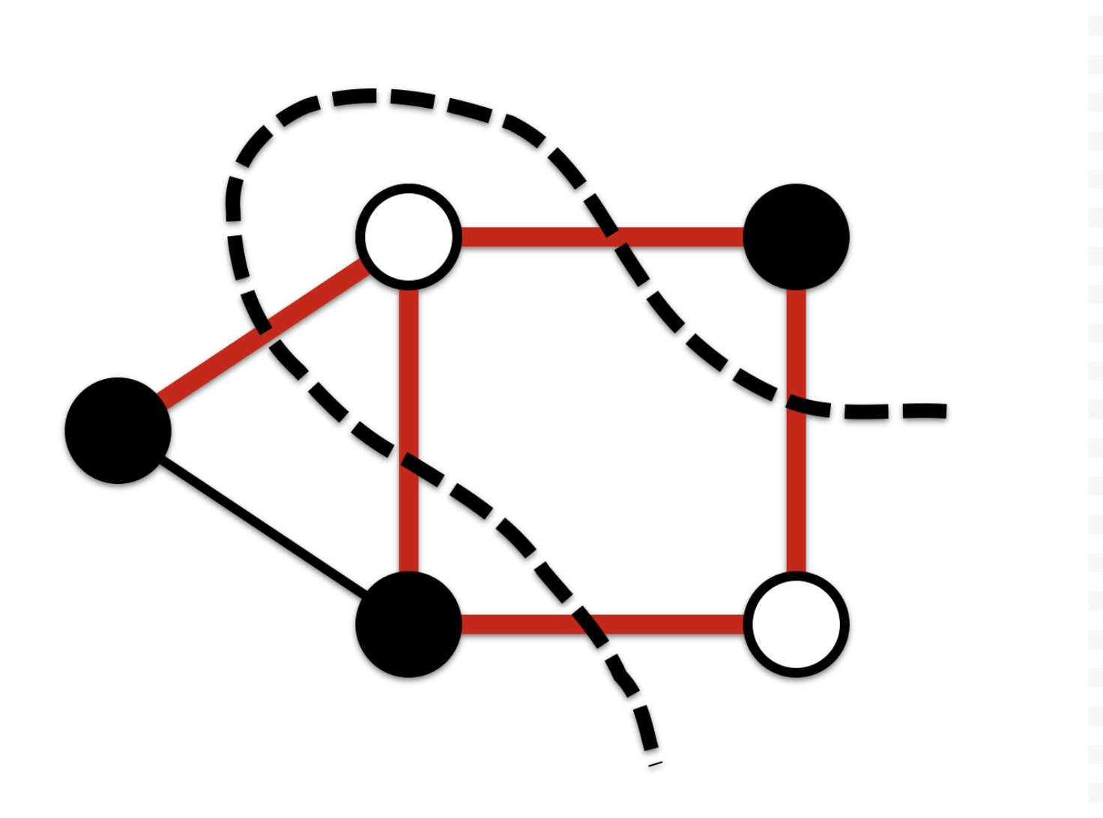
Project Introduction: MAXCUT
Want to find the cut which partitions the graph into two subgraphs which maximizes the number of edges it goes through
Additional constraints
Balanced MAXCUT: we require the two subgraphs to have equal cardinality
Connected MAXCUT: we require the two subgraphs to be connected
IonQ’s Challenge

Slide 5
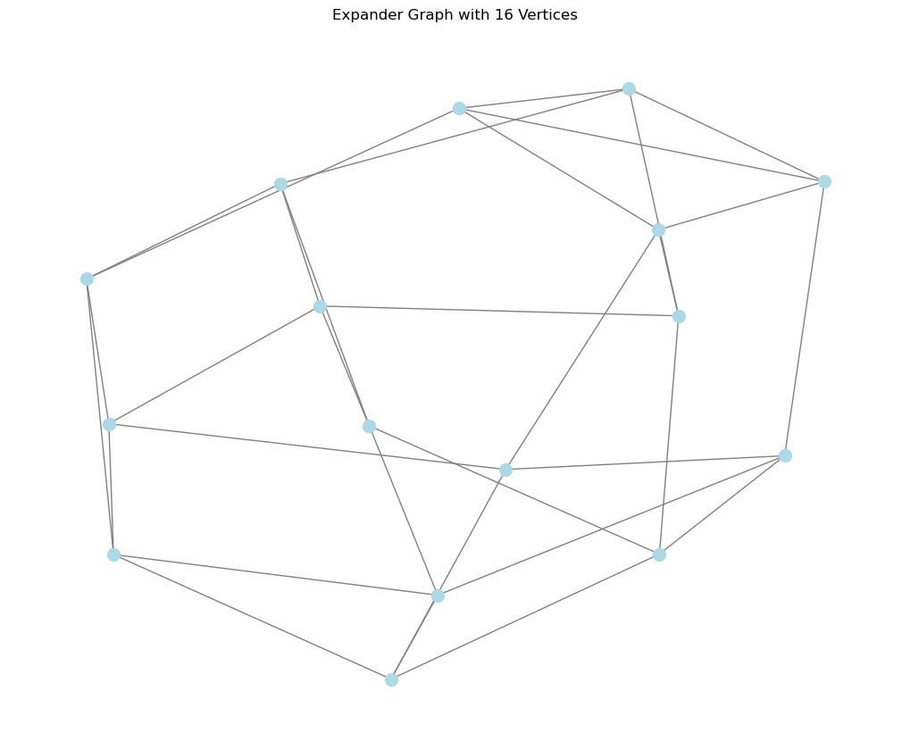
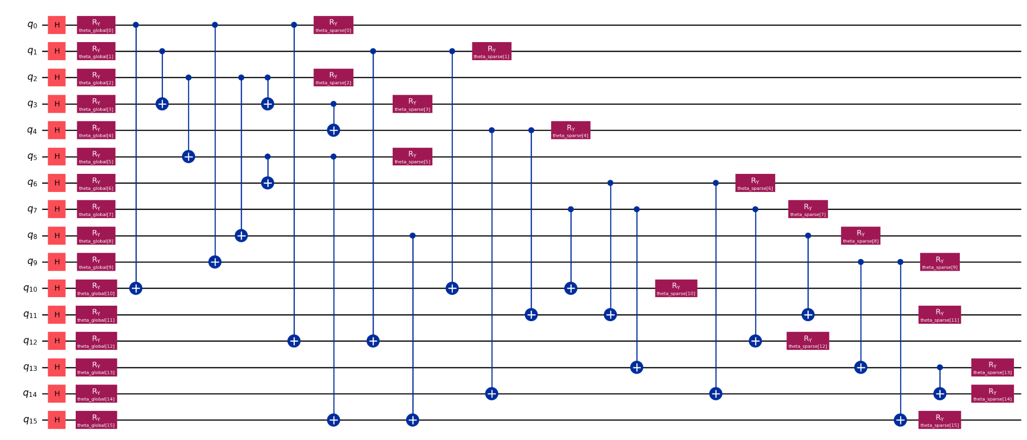
2. Ansatz Development
Want to guess an answer for the quantum circuit architecture and then optimize it.
Every node is a qubit. Edges can be modeled with gates between qubits.
Question: What kind of gates should we use? Want to make the circuit sufficiently expressive, but the score function asks us to minimize CX depth (saves runtime)
IonQ’s Challenge

Slide 6
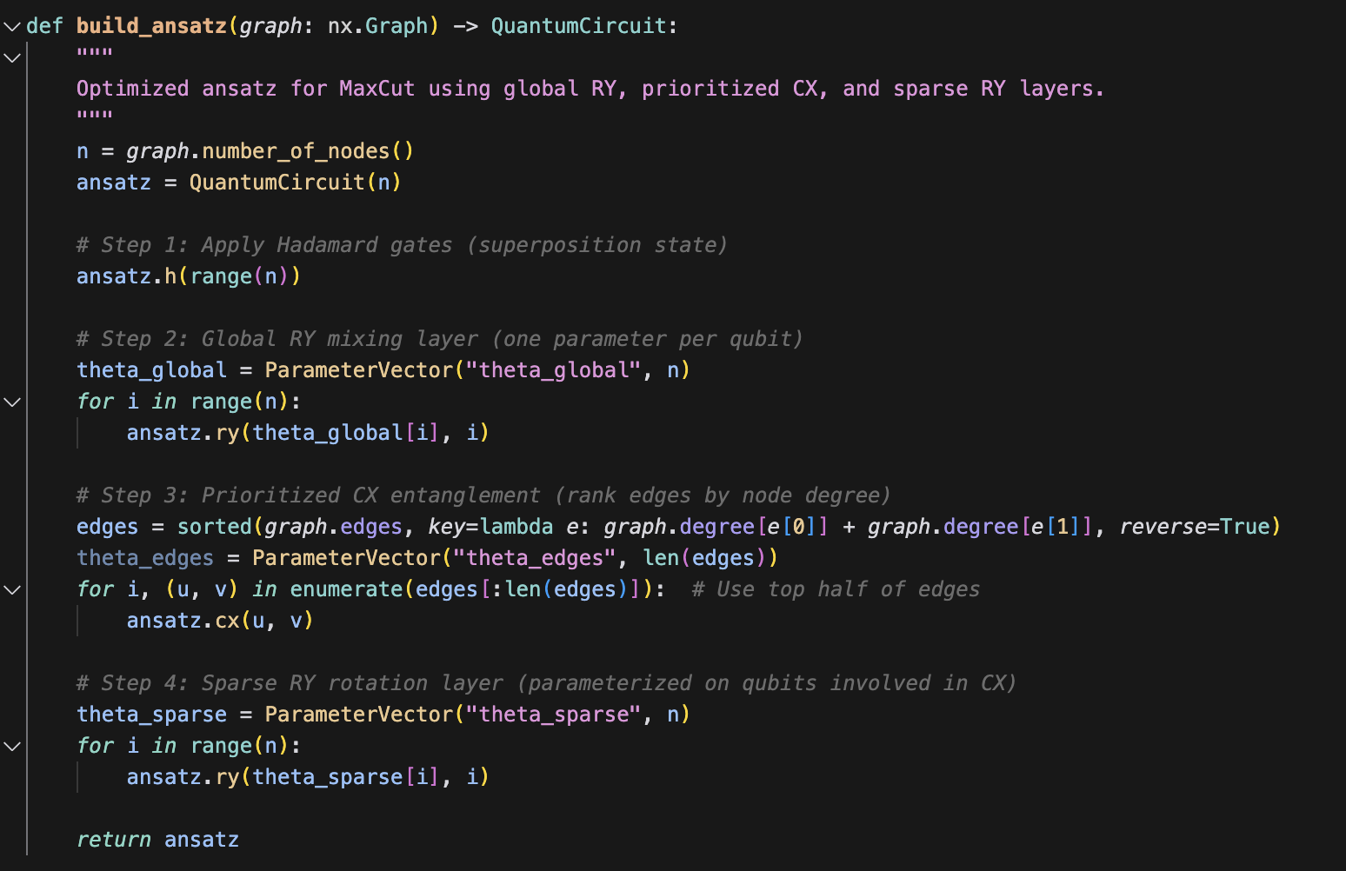
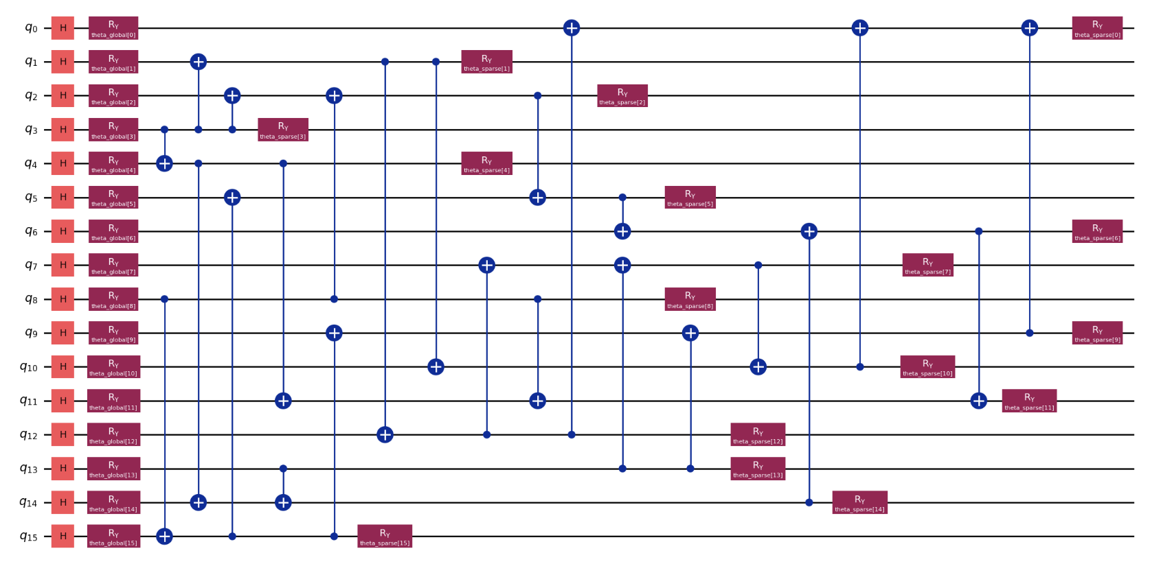
2. Ansatz Choice
Apply Hadamard to each qubit to create a balanced starting state
Global y-rotation of each qubit (allows us to explore wider solution space, starting values besides + state)
Ranked CX entanglement. Entangle along important edges while minimizing distraction.
Rotation of entangled states, allows for learnable control of the entangled pairs.
IonQ’s Challenge

Slide 7
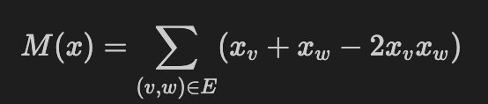
3. Optimization Method
We use IonQ’s varQITE algorithm with a decreased number of shots (500 instead of 10,000) and a Learning Rate Scheduler
Decreases computation time with less shots
Slight noise in training prevents overfitting to local minima
Base Hamiltonian term:
For each edge: -1 if in opposite subgraphs, +0 if in same subgraph
(negative sign introduced in training)
IonQ’s Challenge

Slide 8
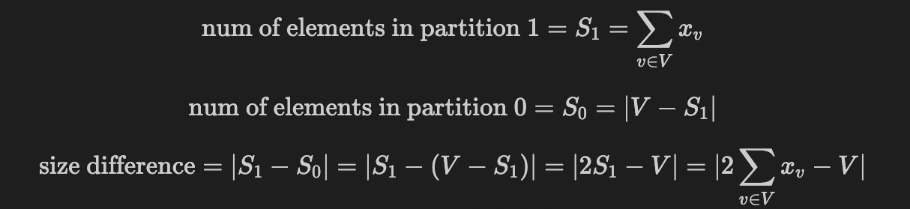


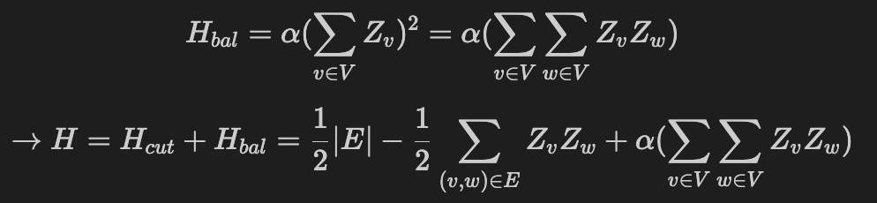
4. Balanced MaxCut Hamiltonian
Question 2: Adds the constraint that the partition must be perfectly balanced
Need to derive a new Hamiltonian (loss function):
Substituting in
IonQ’s Challenge

Slide 9
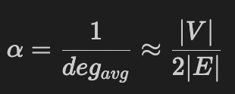
4. Balanced MaxCut Hamiltonian
In implementation, choosing appropriate weight value ɑ is crucial
Ideal ɑ is different for each graph
Intuition: the more densely connected a graph is, the less we should emphasize H_{bal}
Starting with a notion of vertex degree and playing around with values, we eventually settled on
Ansatz also changed: every edge (not just half anymore) is connected via a CNOT gate
IonQ’s Challenge

Slide 10
4. Connected MaxCut Hamiltonian
Finding MaxCut Hamiltonian presented more difficult problem…
Initially explored many different solutions - adding weighted term w/ graph Laplacian, trying more expressive Ansatz, different “connectivity penalty terms”, thinking of graphs as weighted spanning tree
Even tried brute force calculations to try and find good weight values for Laplacian
Eventually found “Nudge” Hamiltonian
IonQ’s Challenge

Slide 11
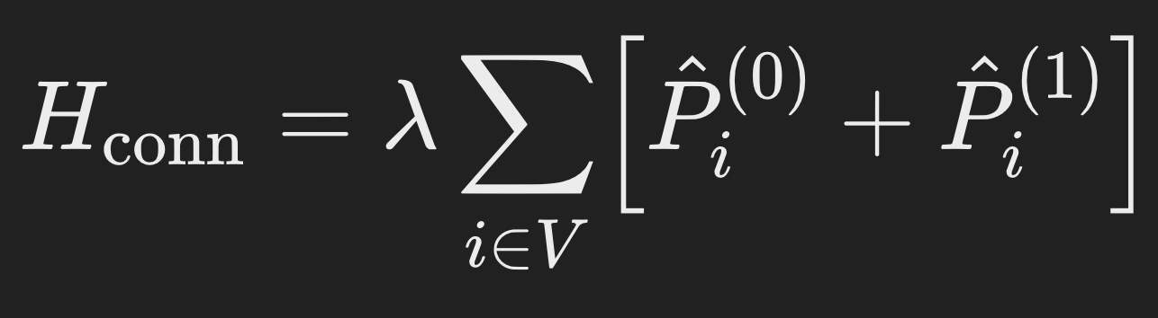
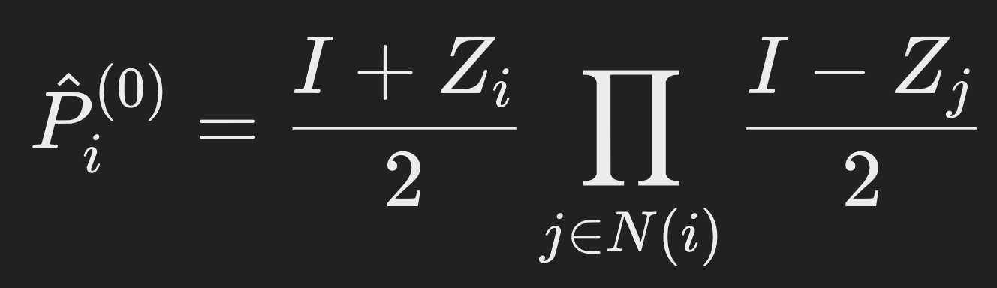
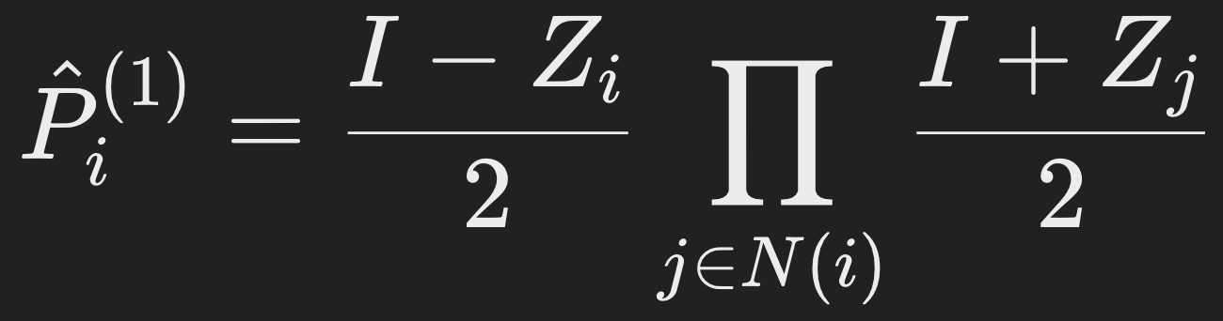
4. Connected MaxCut Hamiltonian
0 loss added if the subgraphs are connected
Lambda is added for every node which has no neighbor in subgraph
Our guess: lambda = davg = 2|E|/n → maybe optimized to work well?
IonQ’s Challenge

Slide 12
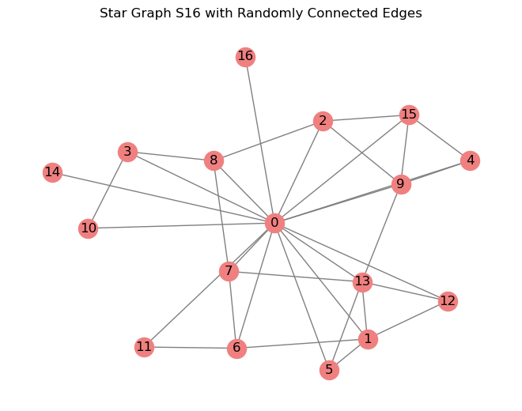
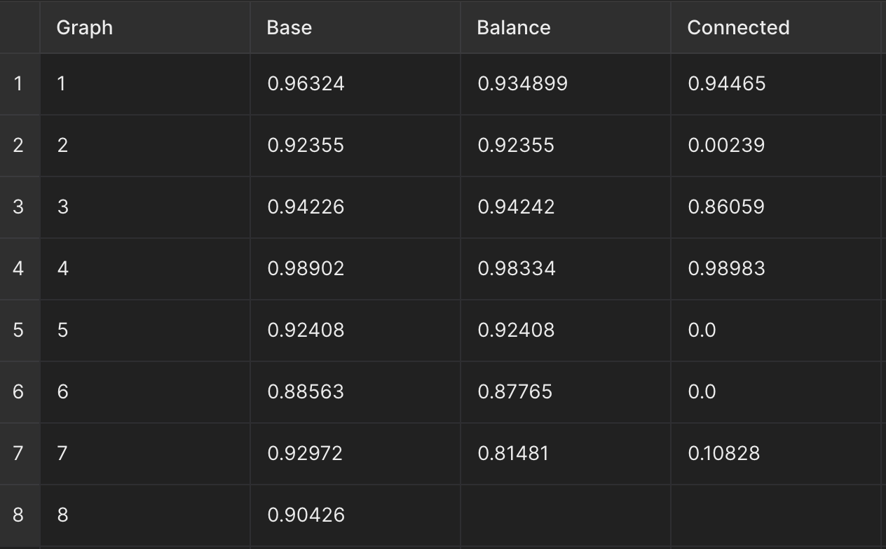
5. Results
Solutions perform well on well-connected graphs. Very sparse graphs (graph6 and our star graph) are more difficult to solve and especially difficult to balance and connect
16-Star Graph augmented with 0.4 edge probability. Irregular structure made balancing especially difficult
IonQ’s Challenge
Notes:
Tyler Chen
\

Slide 13
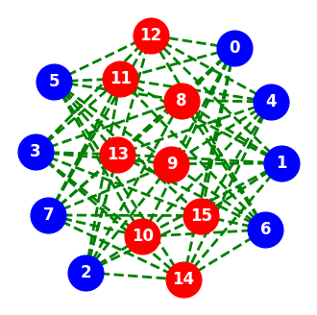
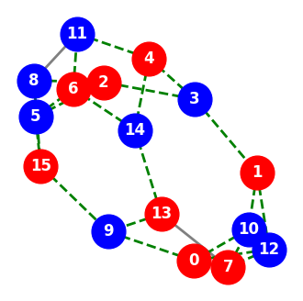
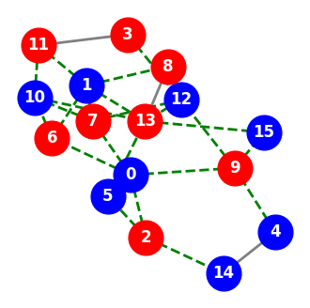
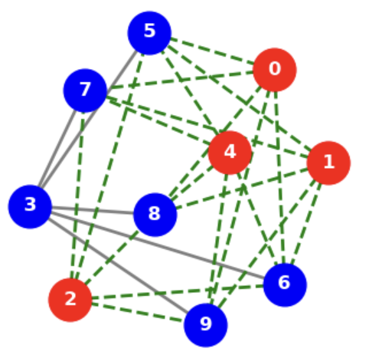
5. Results
Scoring is harsh: balanced and connected solutions must perfectly satisfy its constraints and solve MaxCut
Our most likely solutions found the correct solution in all balanced cases and some of the connected cases:
IonQ’s Challenge
Notes:
Tyler Chen
\

Slide 14
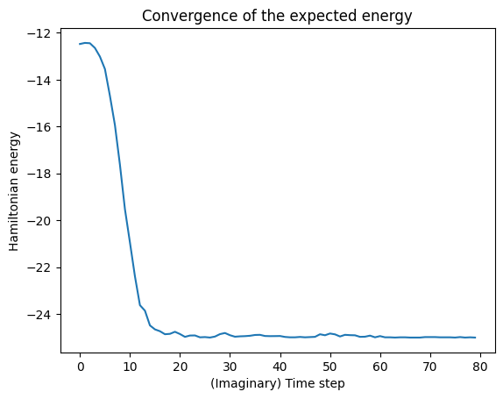
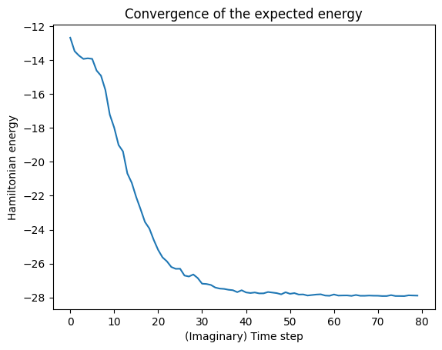
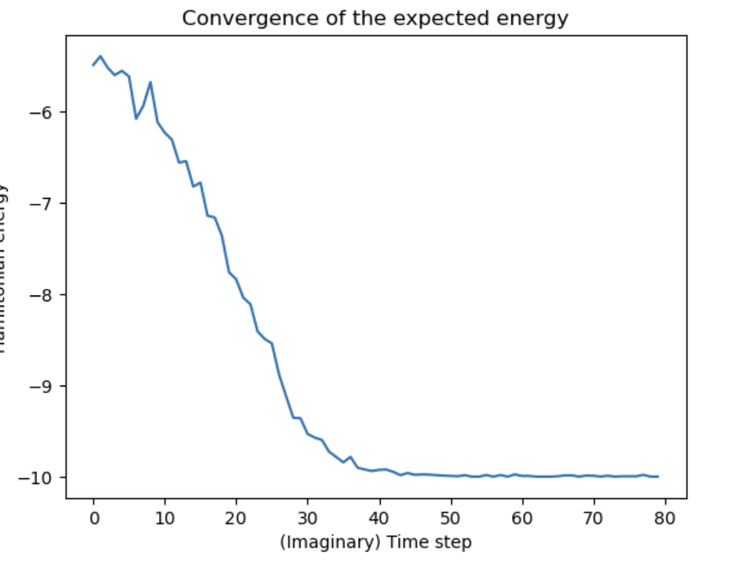
5. Results
Almost every training loss converges → Ran into problems with local minima of the Hamiltonians (e.g. balanced graph with cut score just under optimal cut score)
Solved this using different learning techniques: adaptive weighting, learning rate scheduling, decreasing shot count
IonQ’s Challenge
Convergence graphs for solving problem 2 on graphs 3 and 6 and problem 3 on graph 4. All submitted cases, regardless of constraint or score, converged.
Notes:
Tyler Chen
\

Slide 15
Thank You!

